Slide 1
OPER 618 Lesson 16 Coalition Game Analysis
Dr. Brian J. Lunday
Office: Rm 201E, Bldg 641

Slide 2
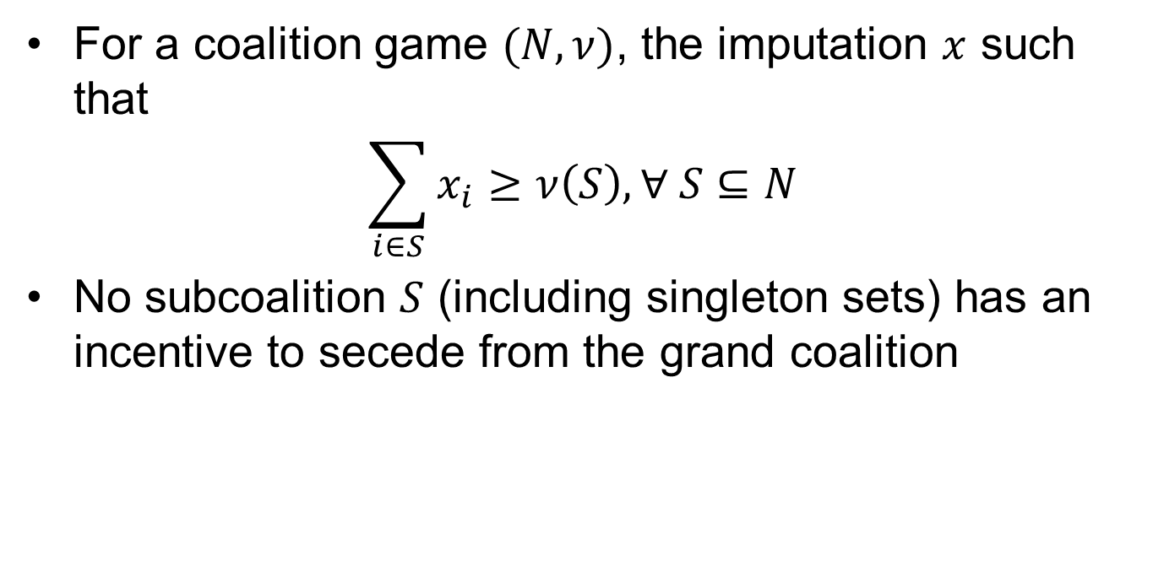
The Core
For a coalition game $(N,ν)$, the imputation $x$ such that
$$\sum_{i∈S}{x_{i}}≥ν\left(S\right), ∀ S⊆N$$
No subcoalition $S$ (including singleton sets) has an incentive to secede from the grand coalition

Slide 3





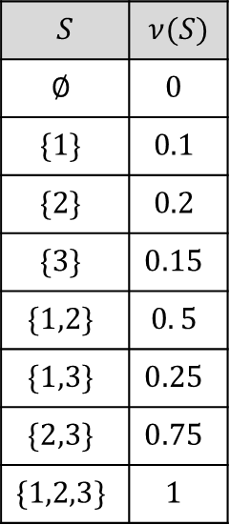




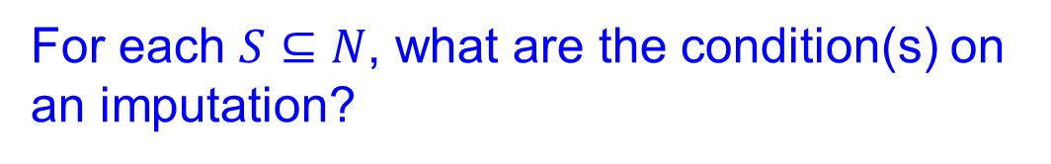

Coalition Game Example 1
For each $S⊆N$, what are the condition(s) on an imputation?
$$N=\{1,2,3\}$$
$$S$$ | $$ν(S)$$
$$∅$$ | $$0$$
$$\{1\}$$ | $$0.1$$
$$\{2\}$$ | $$0.2$$
$$\{3\}$$ | $$0.15$$
$$\{1,2\}$$ | $$0. 5$$
$$\{1,3\}$$ | $$0.25$$
$$\{2,3\}$$ | $$0.75$$
$$\{1,2,3\}$$ | $$1$$
$$x=(1,0,0)$$
$$x_{2}≥0. 2$$
$$x_{3}≥0. 15$$
$$x_{1}+x_{2}≥0. 5$$
$$x_{1}+x_{3}≥0. 25$$
$$x_{2}+x_{3}≥0. 75$$
$$x_{1}≥0. 1$$
$$(0,1,0)$$
$$(0,0,1)$$

Slide 4

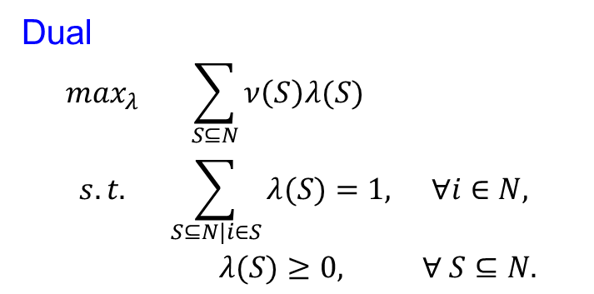

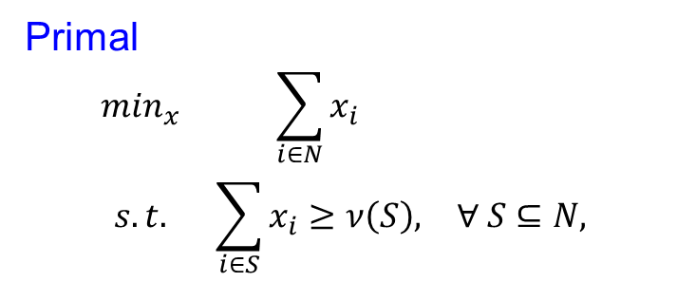
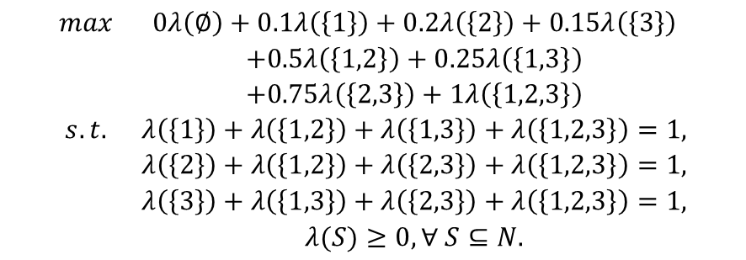
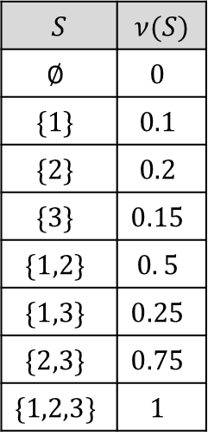
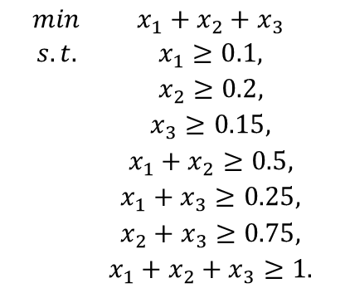
The Core Linear Feasibility Problem – Example 1
Primal
$$\begin{matrix}\min_{x} & \sum_{i∈N}{x_{i}} & \\ s.t. & \sum_{i∈S}{x_{i}}≥ν\left(S\right), & ∀ S⊆N,\end{matrix}$$
Dual
$$\begin{matrix}\max_{λ} & \sum_{S⊆N}{ν\left(S\right)λ(S) } & \\ s.t. & \sum_{S⊆N|i∈S}{λ(S)}=1, & ∀i∈N, \\ & λ(S)≥0, & ∀ S⊆N.\end{matrix}$$
$$\begin{matrix}min & x_{1}+x_{2}+x_{3} \\ s.t. & x_{1}≥0.1, \\ & x_{2}≥0.2, \\ & x_{3}≥0.15, \\ & x_{1}+x_{2}≥0.5, \\ & x_{1}+x_{3}≥0.25, \\ & x_{2}+x_{3}≥0.75, \\ & x_{1}+x_{2}+x_{3}≥1.\end{matrix}$$
$$S$$ | $$ν(S)$$
$$∅$$ | $$0$$
$$\{1\}$$ | $$0.1$$
$$\{2\}$$ | $$0.2$$
$$\{3\}$$ | $$0.15$$
$$\{1,2\}$$ | $$0. 5$$
$$\{1,3\}$$ | $$0.25$$
$$\{2,3\}$$ | $$0.75$$
$$\{1,2,3\}$$ | $$1$$
$$\begin{matrix}max & 0λ\left(∅\right)+0.1λ\left(\left\{1\right\}\right)+0.2λ\left(\left\{2\right\}\right)+0.15λ\left(\left\{3\right\}\right) \\ & +0.5λ\left(\left\{1,2\right\}\right)+0.25λ\left(\left\{1,3\right\}\right) \\ & +0.75λ\left(\left\{2,3\right\}\right)+1λ\left(\left\{1,2,3\right\}\right) \\ s.t. & λ\left(\left\{1\right\}\right)+λ\left(\left\{1,2\right\}\right)+λ\left(\left\{1,3\right\}\right)+λ\left(\left\{1,2,3\right\}\right)=1, \\ & λ\left(\left\{2\right\}\right)+λ\left(\left\{1,2\right\}\right)+λ\left(\left\{2,3\right\}\right)+λ\left(\left\{1,2,3\right\}\right)=1, \\ & λ\left(\left\{3\right\}\right)+λ\left(\left\{1,3\right\}\right)+λ\left(\left\{2,3\right\}\right)+λ\left(\left\{1,2,3\right\}\right)=1, \\ & λ(S)≥0,∀ S⊆N.\end{matrix}$$
$$x^{∗}=\left(0.25,0.25,0.5\right)$$
$$z^{∗}=1$$
$$λ^{∗}=\left(0,0,0,0,0,0,0,1\right)$$
$$z^{∗}=1$$

Slide 5
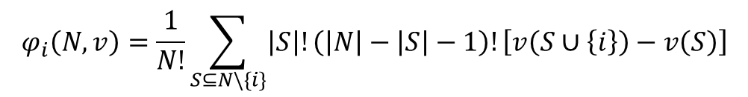
The Core & the Shapley Value Illustrative Example for a Convex Game
$$φ_{i}\left(N,v\right)=\frac{1}{N!}\sum_{S⊆N\backslash \{i\}}{\left|S\right|!\left(\left|N\right|−\left|S\right|−1\right)!\left[v\left(S∪\left\{i\right\}\right)−v\left(S\right)\right]}$$
$$S$$ | $$ν(S)$$
$$∅$$ | $$0$$
$$\{1\}$$ | $$0.1$$
$$\{2\}$$ | $$0.2$$
$$\{3\}$$ | $$0.15$$
$$\{1,2\}$$ | $$0. 5$$
$$\{1,3\}$$ | $$0.25$$
$$\{2,3\}$$ | $$0.75$$
$$\{1,2,3\}$$ | $$1$$
$$φ_{1}\left(N,v\right)=\frac{1}{6}\left[2\left(0.1\right)+1\left(0.3\right)+1\left(0.1\right)+2(0.25)\right]=0.1833$$
1-2-3
1-3-2
2-1-3
3-1-2
2-3-1
3-2-1
$$φ_{2}\left(N,v\right)=\frac{1}{6}\left[2\left(0.2\right)+1\left(0.4\right)+1\left(0.6\right)+2(0.75)\right]=0.4833$$
2-1-3
2-3-1
1-2-3
3-2-1
1-3-2
3-1-2
$$x=(1,0,0)$$
$$φ_{3}\left(N,v\right)=\frac{1}{6}\left[2\left(0.15\right)+1\left(0.15\right)+1\left(0.55\right)+2(0.5)\right]=0.3333$$
3-1-2
3-2-1
1-3-2
2-3-1
1-2-3
2-1-3
$$(0,1,0)$$
$$(0,0,1)$$

Slide 6



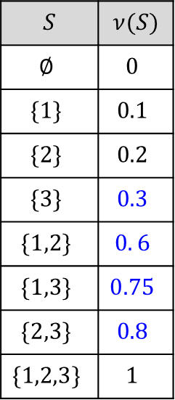


Coalition Game Example 2
For each $S⊆N$, what are the condition(s) on an imputation?
$$N=\{1,2,3\}$$
$$S$$ | $$ν(S)$$
$$∅$$ | $$0$$
$$\{1\}$$ | $$0.1$$
$$\{2\}$$ | $$0.2$$
$$\{3\}$$ | $$0.3$$
$$\{1,2\}$$ | $$0. 6$$
$$\{1,3\}$$ | $$0.75$$
$$\{2,3\}$$ | $$0.8$$
$$\{1,2,3\}$$ | $$1$$
$$x=(1,0,0)$$
$$x_{2}≥0. 2$$
$$x_{3}≥0. 3$$
$$x_{1}+x_{3}≥0. 75$$
$$x_{1}+x_{2}≥0. 6$$
$$x_{1}≥0. 1$$
$$x_{2}+x_{3}≥0. 8$$
$$(0,1,0)$$
$$(0,0,1)$$

Slide 7


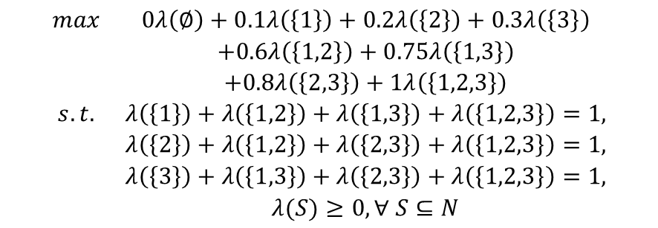
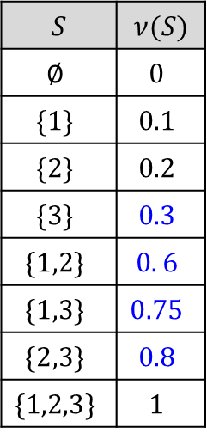
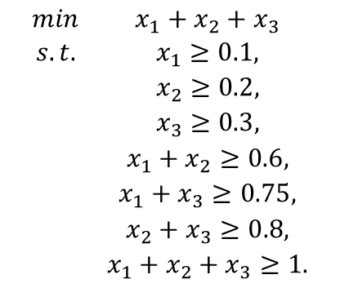
The Core Linear Feasibility Problem – Example 2
Primal
$$\begin{matrix}\min_{x} & \sum_{i∈N}{x_{i}} & \\ s.t. & \sum_{i∈S}{x_{i}}≥ν\left(S\right), & ∀ S⊆N,\end{matrix}$$
Dual
$$\begin{matrix}\max_{λ} & \sum_{S⊆N}{ν\left(S\right)λ(S) } & \\ s.t. & \sum_{S⊆N|i∈S}{λ(S)}=1, & ∀i∈N, \\ & λ(S)≥0, & ∀ S⊆N.\end{matrix}$$
$$\begin{matrix}min & x_{1}+x_{2}+x_{3} \\ s.t. & x_{1}≥0.1, \\ & x_{2}≥0.2, \\ & x_{3}≥0.3, \\ & x_{1}+x_{2}≥0.6, \\ & x_{1}+x_{3}≥0.75, \\ & x_{2}+x_{3}≥0.8, \\ & x_{1}+x_{2}+x_{3}≥1.\end{matrix}$$
$$S$$ | $$ν(S)$$
$$∅$$ | $$0$$
$$\{1\}$$ | $$0.1$$
$$\{2\}$$ | $$0.2$$
$$\{3\}$$ | $$0.3$$
$$\{1,2\}$$ | $$0. 6$$
$$\{1,3\}$$ | $$0.75$$
$$\{2,3\}$$ | $$0.8$$
$$\{1,2,3\}$$ | $$1$$
$$\begin{matrix}max & 0λ\left(∅\right)+0.1λ\left(\left\{1\right\}\right)+0.2λ\left(\left\{2\right\}\right)+0.3λ\left(\left\{3\right\}\right) \\ & +0.6λ\left(\left\{1,2\right\}\right)+0.75λ\left(\left\{1,3\right\}\right) \\ & +0.8λ\left(\left\{2,3\right\}\right)+1λ\left(\left\{1,2,3\right\}\right) \\ s.t. & λ\left(\left\{1\right\}\right)+λ\left(\left\{1,2\right\}\right)+λ\left(\left\{1,3\right\}\right)+λ\left(\left\{1,2,3\right\}\right)=1, \\ & λ\left(\left\{2\right\}\right)+λ\left(\left\{1,2\right\}\right)+λ\left(\left\{2,3\right\}\right)+λ\left(\left\{1,2,3\right\}\right)=1, \\ & λ\left(\left\{3\right\}\right)+λ\left(\left\{1,3\right\}\right)+λ\left(\left\{2,3\right\}\right)+λ\left(\left\{1,2,3\right\}\right)=1, \\ & λ(S)≥0,∀ S⊆N\end{matrix}$$
$$x^{∗}=\left(0.375,0.425,0.475\right)$$
$$z^{∗}=1.275$$
$$λ^{∗}=\left(0,0,0,0,0.5,0.5,0.5,0\right)$$
$$z^{∗}=1.275$$

Slide 8




The Core & the Shapley Value Illustrative Example for a Nonconvex Game
$$φ_{i}\left(N,v\right)=\frac{1}{N!}\sum_{S⊆N\backslash \{i\}}{\left|S\right|!\left(\left|N\right|−\left|S\right|−1\right)!\left[v\left(S∪\left\{i\right\}\right)−v\left(S\right)\right]}$$
$$S$$ | $$ν(S)$$
$$∅$$ | $$0$$
$$\{1\}$$ | $$0.1$$
$$\{2\}$$ | $$0.2$$
$$\{3\}$$ | $$0.3$$
$$\{1,2\}$$ | $$0.6$$
$$\{1,3\}$$ | $$0.75$$
$$\{2,3\}$$ | $$0.8$$
$$\{1,2,3\}$$ | $$1$$
$$φ_{1}\left(N,v\right)=\frac{1}{6}\left[2\left(0.1\right)+1\left(0.4\right)+1\left(0.45\right)+2(0.2)\right]=0.2417$$
1-2-3
1-3-2
2-1-3
3-1-2
2-3-1
3-2-1
$$φ_{2}\left(N,v\right)=\frac{1}{6}\left[2\left(0.2\right)+1\left(0.5\right)+1\left(0.5\right)+2(0.25)\right]=0.3167$$
2-1-3
2-3-1
1-2-3
3-2-1
1-3-2
3-1-2
$$x=(1,0,0)$$
$$φ_{3}\left(N,v\right)=\frac{1}{6}\left[2\left(0.3\right)+1\left(0.65\right)+1\left(0.6\right)+2(0.4)\right]=0.4417$$
3-1-2
3-2-1
1-3-2
2-3-1
1-2-3
2-1-3
$$(0,1,0)$$
$$(0,0,1)$$

Slide 9
Game Classification & Core Properties
Every constant-sum game that is not additive has an empty core.
Every convex game has a nonempty core.
In every convex game, the Shapley value is in the core!

Slide 10
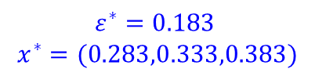

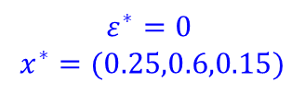
ε-core & Least Core
ε-core
$$\sum_{i∈S}{x_{i}}≥ν\left(S\right)−ε, ∀ S⊂N$$
Least core
$$\begin{matrix}\min_{x} & ε & \\ s.t. & \sum_{i∈S}{x_{i}}≥ν\left(S\right)−ε, & ∀ S⊂N, \\ & \sum_{i∈N}{x_{i}}=1. & \end{matrix}$$
$$x=(1,0,0)$$
$$(0,1,0)$$
$$(0,0,1)$$
$$x=(1,0,0)$$
$$x=(1,0,0)$$
$$ε^{∗}=0$$
$$x^{∗}=(0.25,0.6,0.15)$$
$$ε^{∗}=0.183$$
$$x^{∗}=(0.283,0.333,0.383)$$
$$(0,1,0)$$
$$(0,0,1)$$
$$(0,1,0)$$
$$(0,0,1)$$

Slide 11
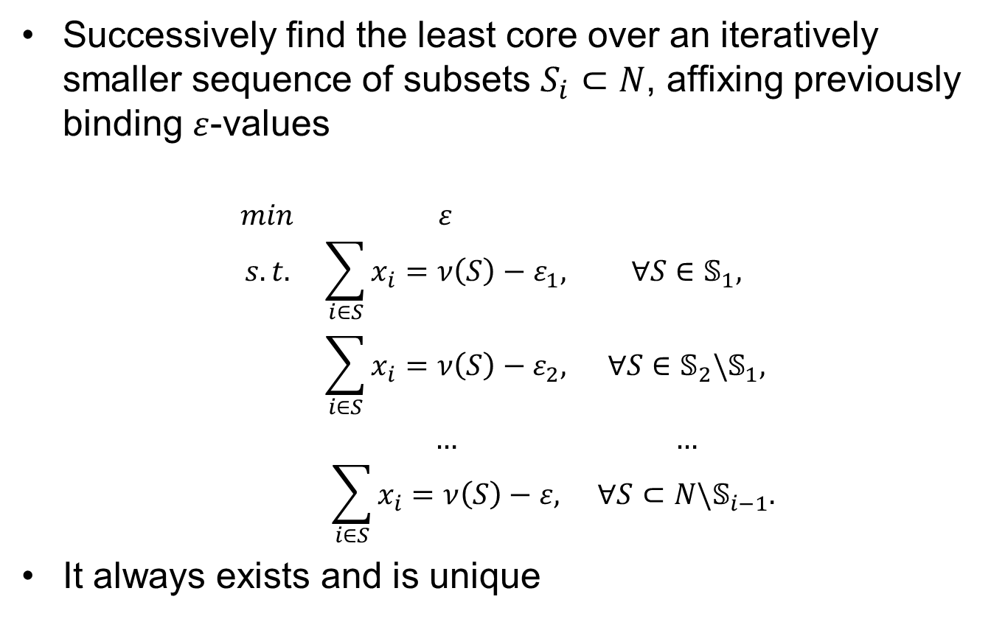
Nucleolus
Successively find the least core over an iteratively smaller sequence of subsets $S_{i}⊂N$, affixing previously binding $ε$-values
$$\begin{matrix}min & ε & \\ s.t. & \sum_{i∈S}{x_{i}}=ν\left(S\right)−ε_{1}, & ∀S∈𝕊_{1}, \\ & \sum_{i∈S}{x_{i}}=ν\left(S\right)−ε_{2}, & ∀S∈𝕊_{2}\backslash 𝕊_{1}, \\ & … & … \\ & \sum_{i∈S}{x_{i}}=ν\left(S\right)−ε, & ∀S⊂N\backslash 𝕊_{i−1}.\end{matrix}$$
It always exists and is unique

Slide 12
Questions & Discussion

